Slide 1
Maryland Fiscal Outlook & Policy Choices
Christopher Meyer (he/him)
Research Analyst
AFSCME Webinar: Adapting & Thriving Remotely
October 14, 2020

Slide 2
Every Marylander should be able to achieve their full potential in a healthy economy that offers a widely shared, rising standard of living
Notes:
research, analysis,
strategic communications,
public education,
and grassroots alliances
Much of what we do is in coalition.
Paid sick leave report
Fight for $15
Our most important coalition is the State Priorities Partnership (41 other states)
Peer learning
We bring economic perspective
Focus on budget and tax policy

Slide 3
A healthy economy is one that works for all of us.
Our shared investments are part of the foundation of a thriving community:
World-class public schools
Modern transportations networks
Inviting public spaces
Effective government
Reliable public health infrastructure
…
Public policy is not neutral:
We must work to break down barriers and build prosperity for Marylanders of every race, ethnicity, gender, class, disability
You can’t build a strong economy out of bad jobs.
Our work:
Earned sick days
$15 minimum wage
Prevent counterproductive tax cuts
Protect high-quality state and local jobs
Prevent harmful budget cuts
Raise revenue fairly

Slide 4
Maryland’s Fiscal Outlook Has Improved
The Future Remains Uncertain
1 Board of Revenue Estimates.

Slide 5
Maryland’s Fiscal Outlook Has Improved
The Future Remains Uncertain
1 Board of Revenue Estimates with MDCEP calculations.

Slide 6
Maryland’s Fiscal Outlook Has Improved
The Future Remains Uncertain
1 Board of Revenue Estimates with MDCEP calculations.

Slide 7
Maryland Faces a Choice
Strengthen our revenue system
Continue underfunding schools
Cut other essential services

Slide 8
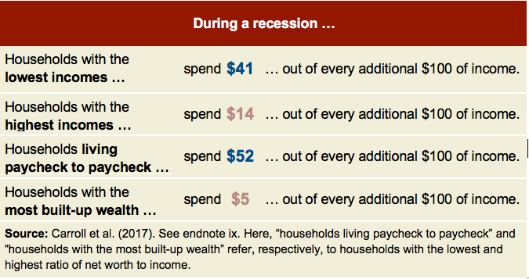
We Can’t Cut our Way to a Healthy Economy
July 2020: Maryland lost 17,500 state and local jobs since February
Good Jobs → Secure Families → Successful Businesses
Each $1.00 in public services adds up to $1.15 to Marylanders’ take-home income
1 Economic Policy Institute job loss data; Carroll et al. (2017) estimates of the marginal propensity to consume; multiplier estimate based on MDCEP analysis of DLS corporate tax cut model.

Slide 9
A Better Way: Fix Our Tax Code
Override Tobacco Tax Veto: $84 million
Close Corporate Tax Loopholes: $172 million
Offset Special Treatment of Capital Gains: $182 million
Repeal 2014 Estate Tax Giveaway: $117 million
Close the LLC Loophole: $316 million
Reform Maryland’s Income Tax: $586 million
Legalize Cannabis: $256 million
More Ambitious Options: $1.8 billion to $3.6 billion
1 Revenue estimates for cannabis, more ambitious options from Institute on Taxation and Economic Policy; other revenues from 2020 DLS fiscal notes.

Slide 10
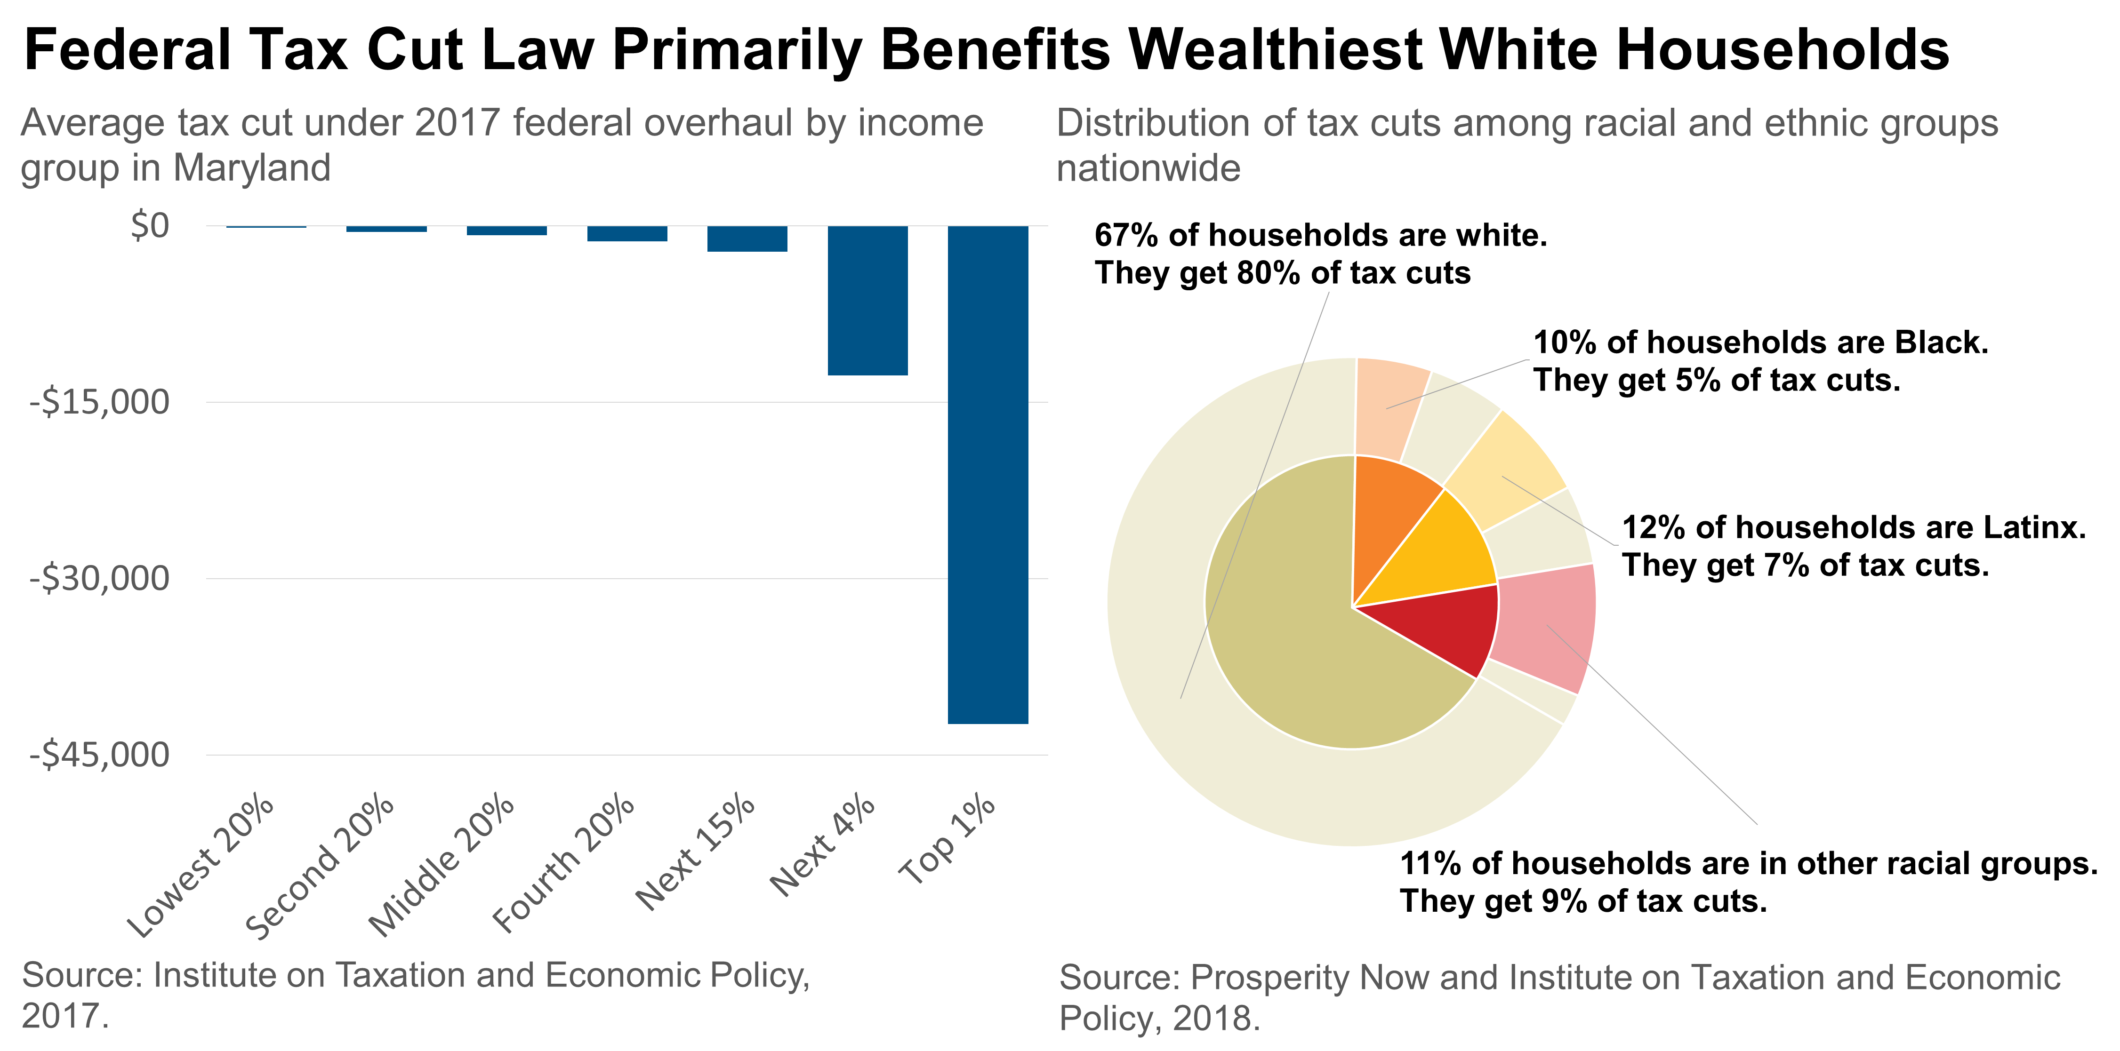
Trump Tax Cuts: A Windfall for the Powerful Few
Corporations and Wealthy Individuals Can Afford to Pay More

Slide 11
Business taxes are a smaller share of MD’s economy than in most states
Maryland businesses get a $1.25 return for every $1 they pay in state and local taxes.
(#1 Nationwide)
Ernst & Young, FY 2018 COST report on state and local taxes

Slide 12
Which Path Will Maryland Choose?

Slide 13
www.mdeconomy.org @mdeconomy
410-412-9105 mdcep@mdeconomy.org

